Slide 1
Big Mountain Resort Report
By: Cyndie Jean

Slide 2
Problem identification
Big Mountain Resort has decided to add one chair lift which will increase operating costs by 1.5 million dollars.
Big Mountain Resort must decide whether to:
Increase ticket prices
Cut costs in another department

Slide 3
Recommendation and key findings
The model that saw the biggest revenue was 17 million dollars:
Increased ticket prices by $9.90
Increased the total number of runs by 1
Increased the vertical drop by 150 feet
Increased an additional chair lift
Added 2 acres of snow making

Slide 4
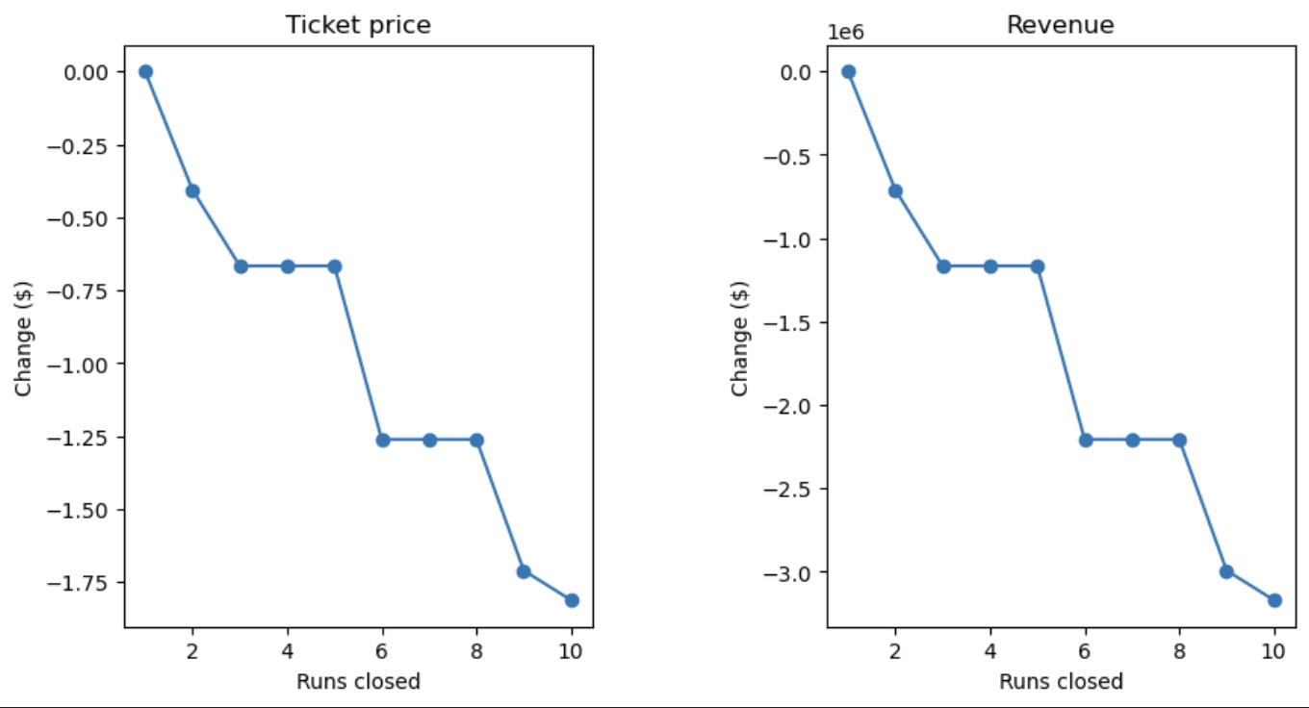
Modeling 1
In this model, they looked at what would happen depending on how many runs were closed.
Closing runs saw a drop in revenue and ticket prices, especially closing 3-10 runs down.

Slide 5
Modeling 2
This model added a run, increased the vertical drop by 150 ft., and installed an extra chair lift.
In this model, it saw the expected revenue to be around 15 million dollars.
It supported a ticket price increase by $8.61

Slide 6
Modeling 3 & 4
Model 3:
This model increased the number of runs by 1, the vertical drop by 150 ft, chair lift by 1, and snow making acres by 2.
This model expected a revenue of 17 million dollars and supported an increase of ticket prices by $9.90
Model 4:
Increases the longest run by .2 miles, adding 4 acres of snow making
This saw no difference in revenue. So, this model should not be considered

Slide 7
Summary and conclusion
Since the resort is already planning on adding an extra chair lift, which will increase operating cost, the best option is to increase ticket prices by $9.90 for the biggest increase in revenue.
Closing any number of runs would cause a drop in ticket prices and revenue.
The best option is to add additional 1 chair lift, 1 run, 2 acres of snow making, and 150 ft vertical drop for the most revenue from the model results

